Slide 1


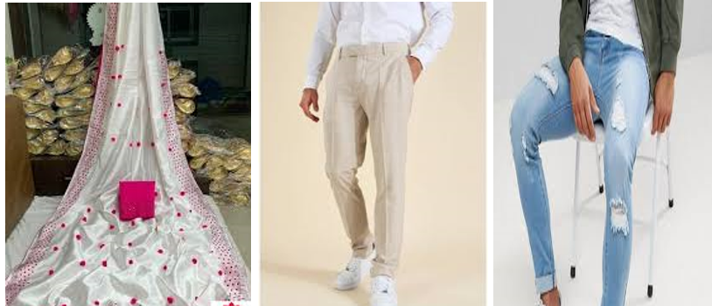
Image Scraping and Classification Project
-Pooja Mishra

Slide 2
In this project, we’ll be performing image classification in which our system will receive an image as input and now the system is aware of a set of categories and its goal is to assign a category to the image. Here we have taken image data from Google of
Sarees (women)
Trousers (men)
Jeans (men)

Slide 3
About Dataset
A total of 600 images were downloaded, which was divided into train and test. I performed an 80-20 split with the train folder having 480 images and the test folder has 120. Both the classes have sarees, jeans & trousers have 160 images each for train set and 40 images each for test set.
Input – 600
Train – 480
Sarees – 160
Trousers – 160
Jeans - 160
Test – 120
Sarees – 40
Trousers – 40
Jeans – 40

Slide 4
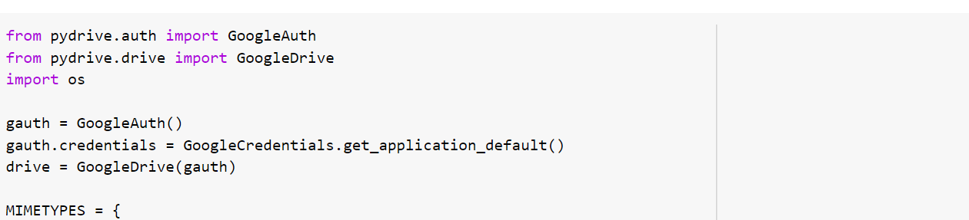
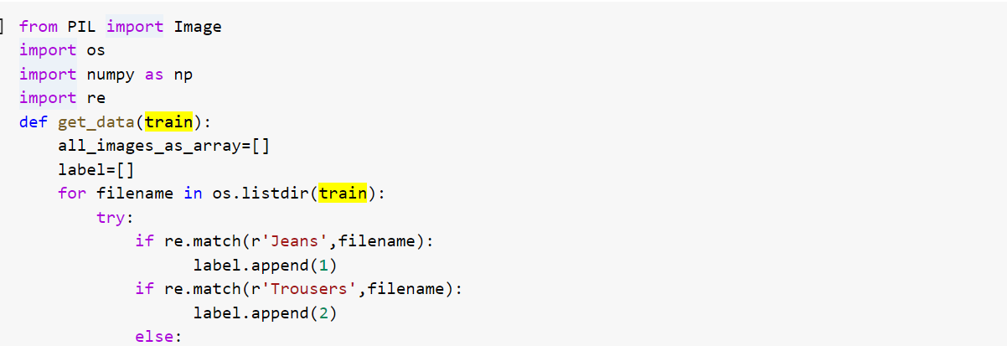
data pre-processing
Next, we are performing some Data Pre-processing and Data Augmentation before we can proceed with building the model.
Image data augmentation is a technique that can be used to artificially expand the size of a training dataset by creating modified versions of images in the dataset.

Slide 5
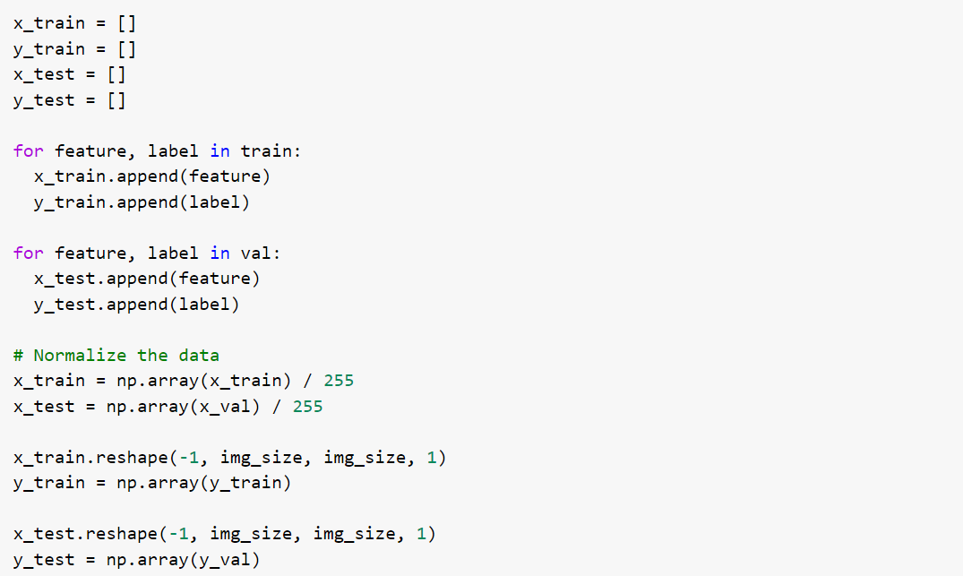
Data Inputs- Logic- Output Relationships
In Data Input -Logic – Output relationships include the train and test split to perform the model building. With train dataset we have features and labels while with test dataset we have only features to predict the labels.

Slide 6
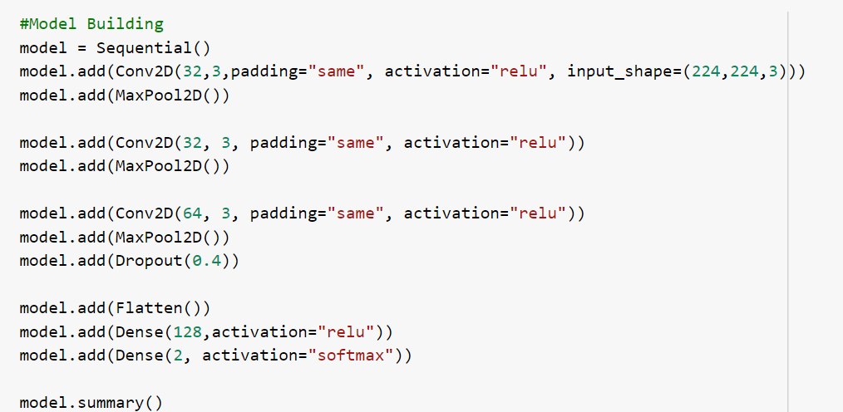
Model Development & Evaluation
To build the model, we’re going to use standard CNN with TensorFlow. The model consists of four convolutional layers before we flatten it and use a dense layer at the very end.

Slide 7
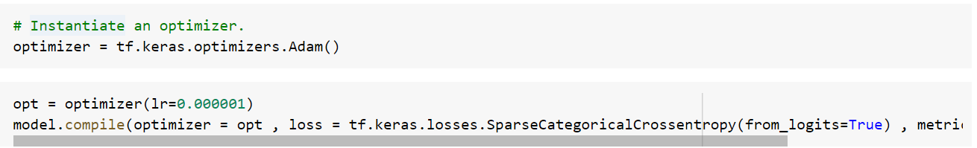
2) Testing of Identified Approaches
In this article, we will use Adam optimizer for the model. As the problem is a classification problem, we need to use categorical cross-entropy as the loss function. Finally, accuracy metrics will be used.

Slide 8
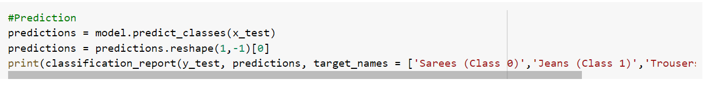
Prediction over test dataset
That is not the end, we saw that our models were misclassifying a lot of images which means that is still room for improvement. We could begin with finding more data or even implementing better and latest architectures that might be better at identifying the features.

Slide 9
Conclusion
All categories precision are higher than our CNN model and also the overall accuracy reached 91% which is really good for such a small dataset. With a bit of hyperparameter tuning and changing parameters, we might be able to achieve a little better performance too!
As suspected, the addition of regularization techniques slows the progression of the learning algorithms and reduces overfitting, resulting in improved performance on the holdout dataset. It is likely that the combination of both approaches with further increase in the number of training epochs will result in further improvements.

Slide 10
THANK YOU

